Slide 1
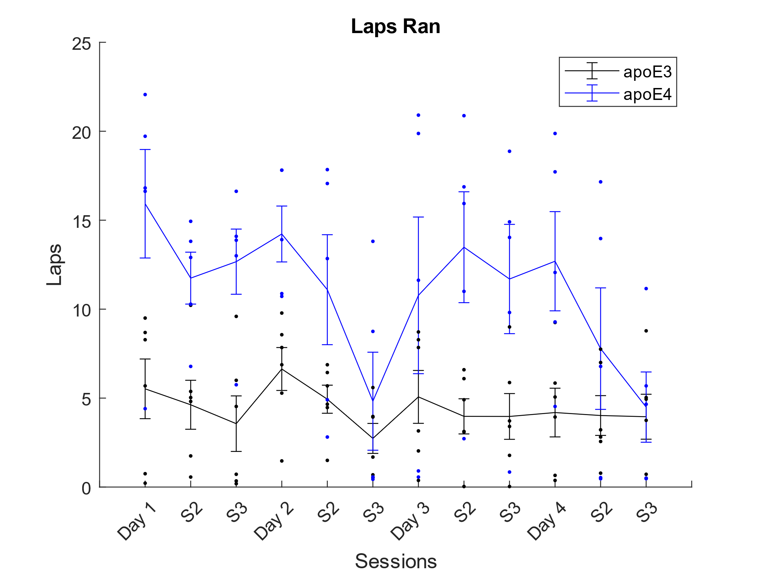
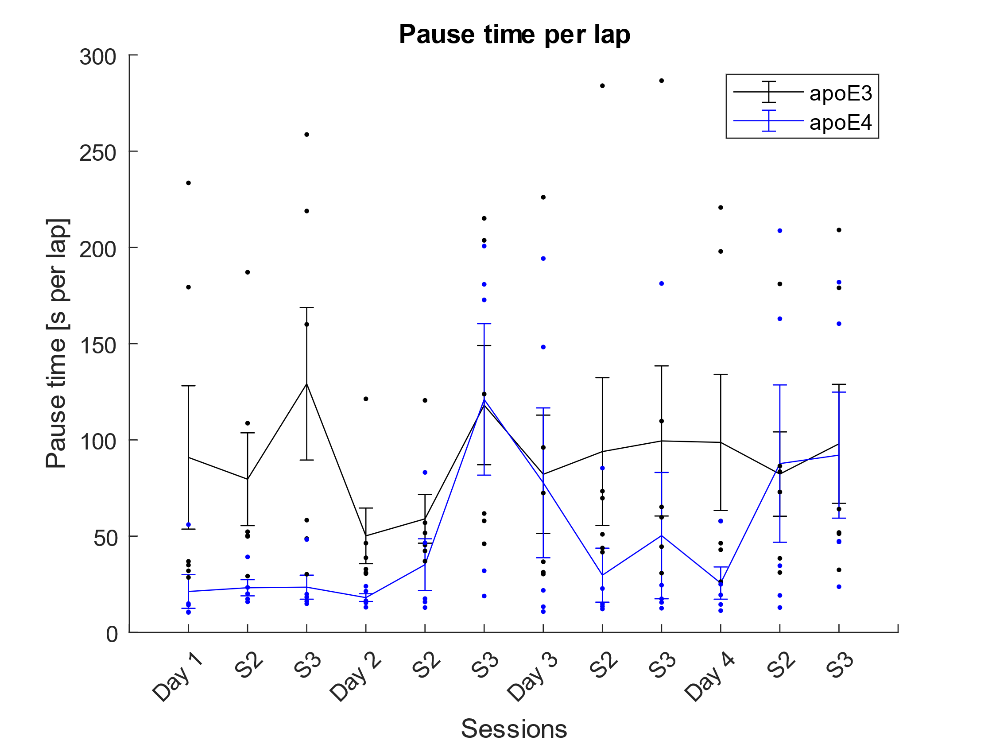
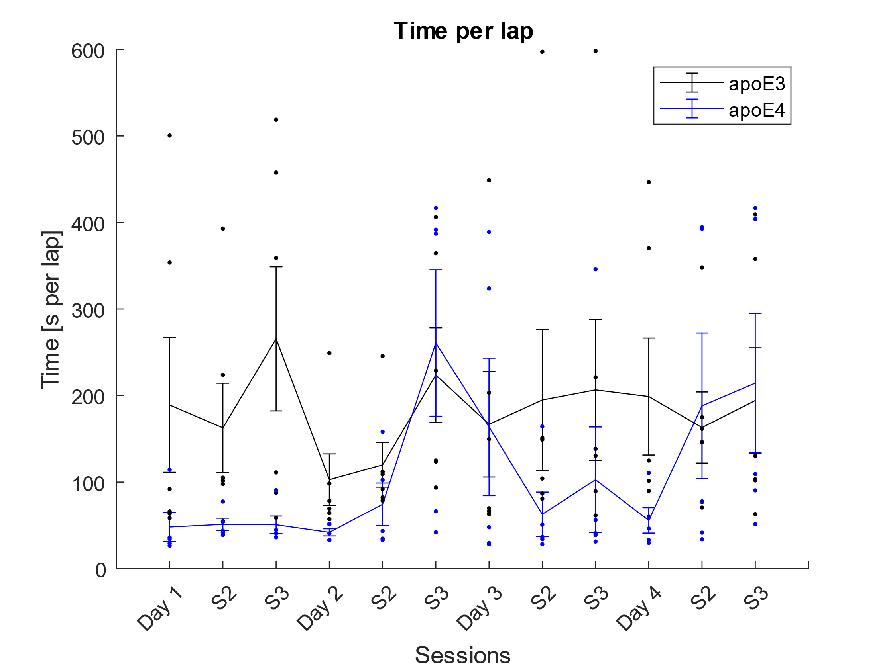
ApoE4 v/s WT
N = (5, 6)
Circle Track Headscan
Behavioral data analyses
Average number of laps ran and pause time per lap – apoE4 ran more laps and paused less than apoE3 per lap

Slide 2
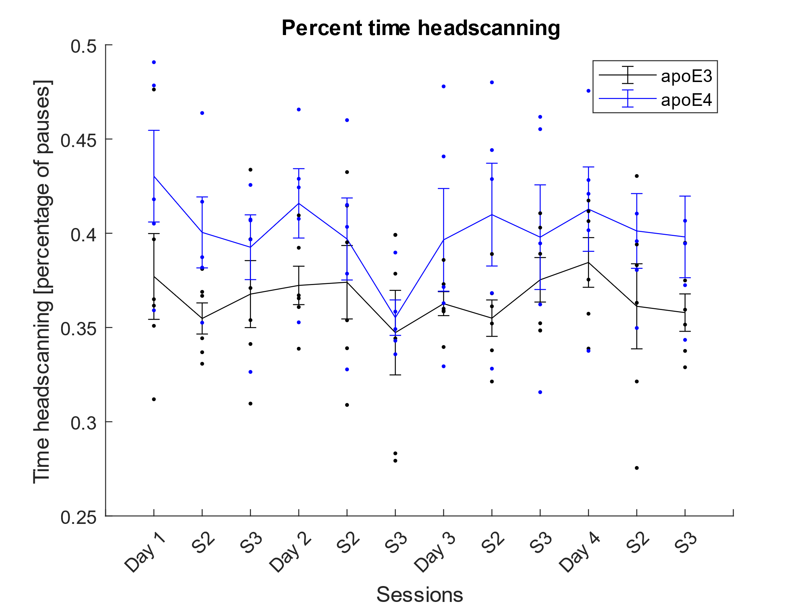
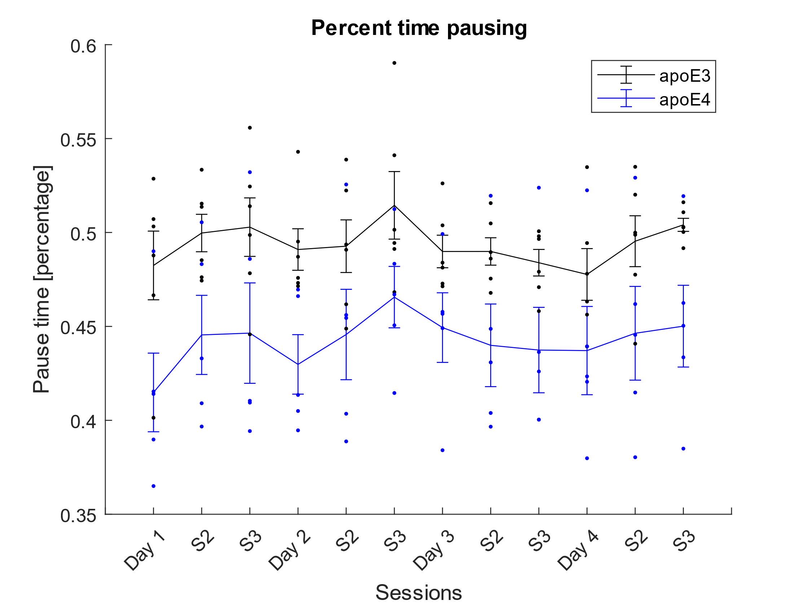
ApoE4 v/s WT
N = (5, 6)
Circle Track Headscan
Behavioral data analyses
Percentage of time headscanning and pausing – apoE4 shows increased headscanning as a percentage of time (overall, not per lap)

Slide 3
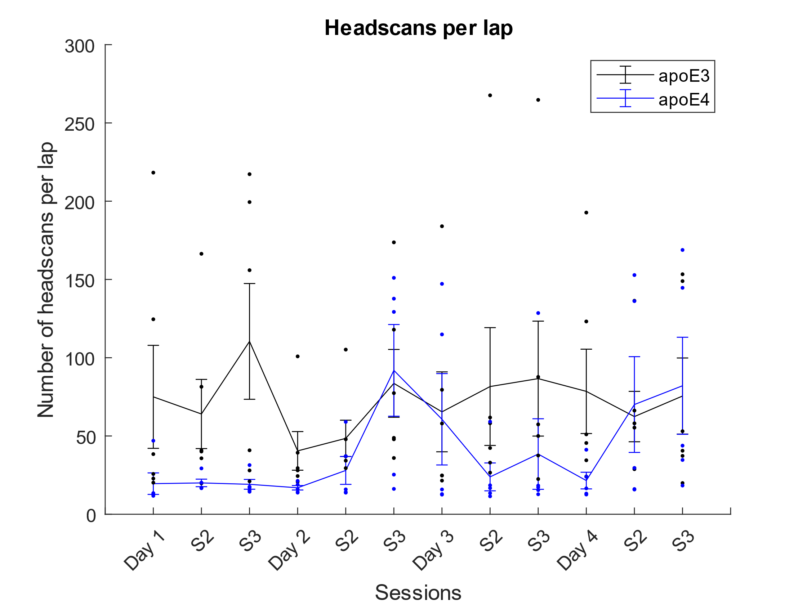
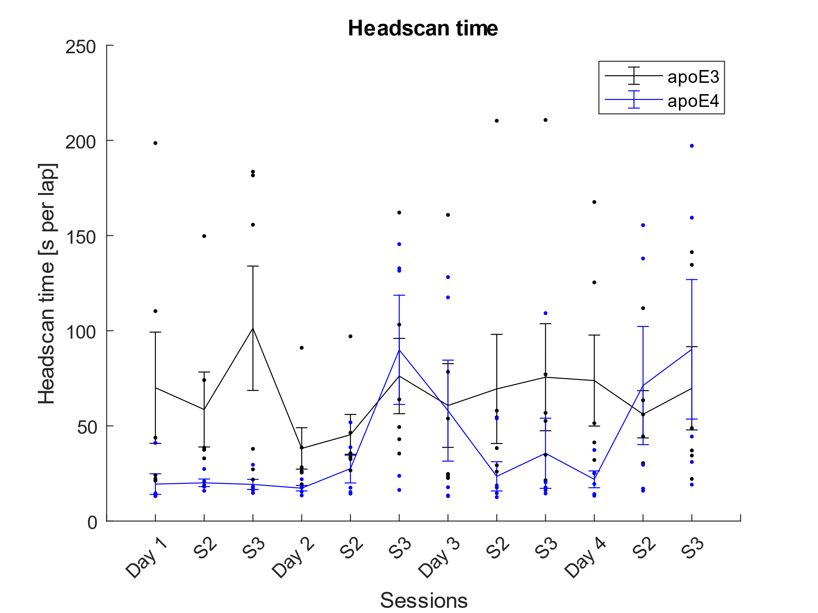
ApoE4 v/s WT
N = (5, 6)
Circle Track Headscan
Behavioral data analyses
Number of headscans per lap and amount of time headscanning per headscan

Slide 4
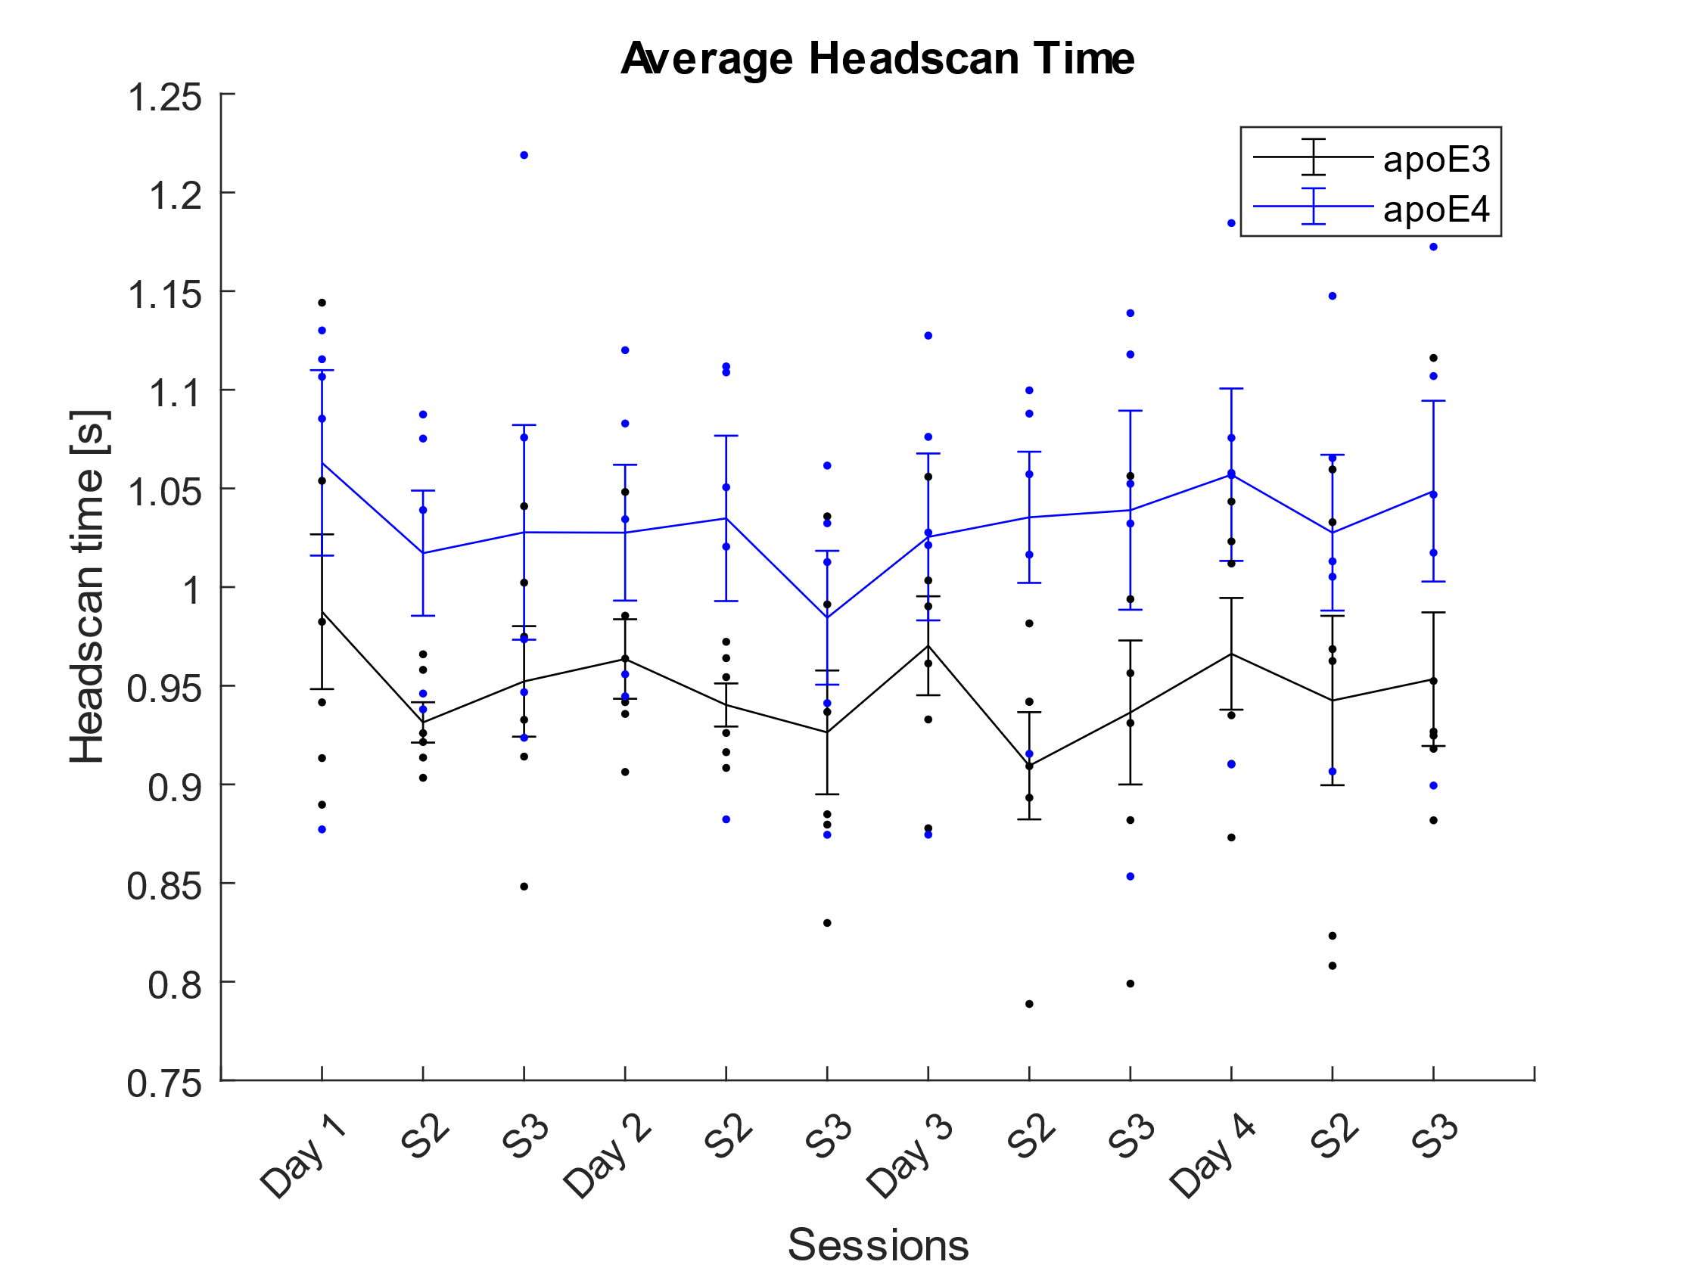
ApoE4 v/s WT
N = (5, 6)
Circle Track Headscan
Behavioral data analyses
Average Headscan Time – Increased headscan duration in apoE4 model

Slide 5
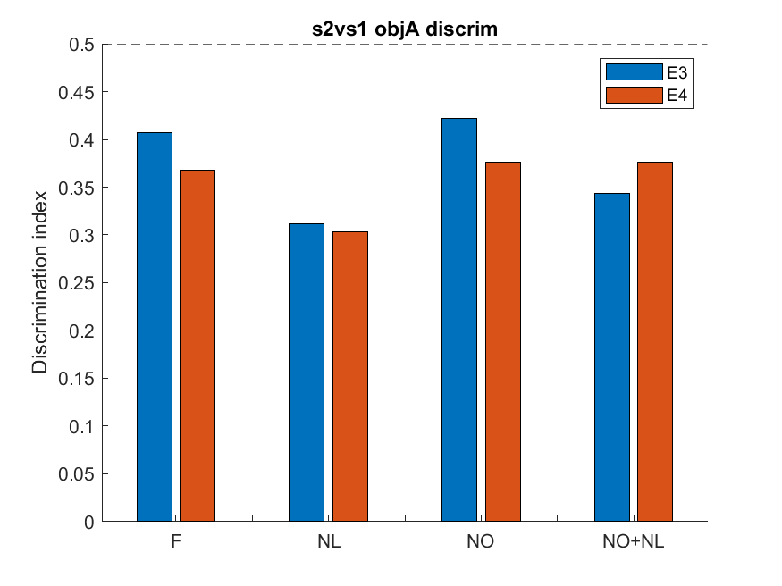
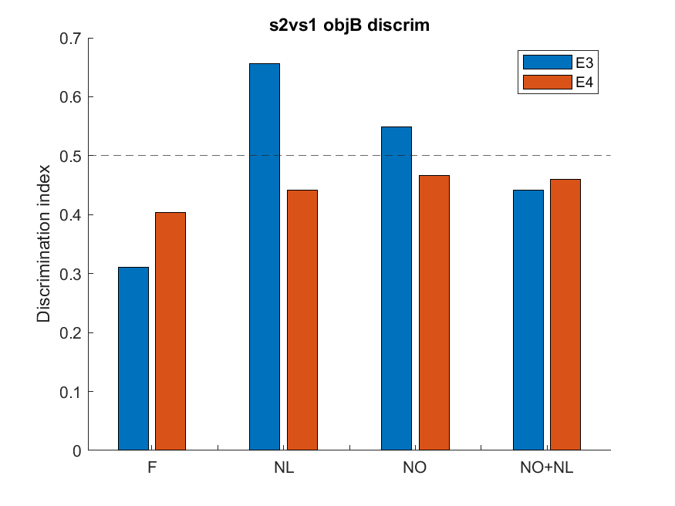
ApoE4 v/s WT
N = (5, 6)
Open Field Association
Behavioral data analyses
Discrimination index of an object across sessions (S2 novel vs S1/S3 familiar)

Slide 6
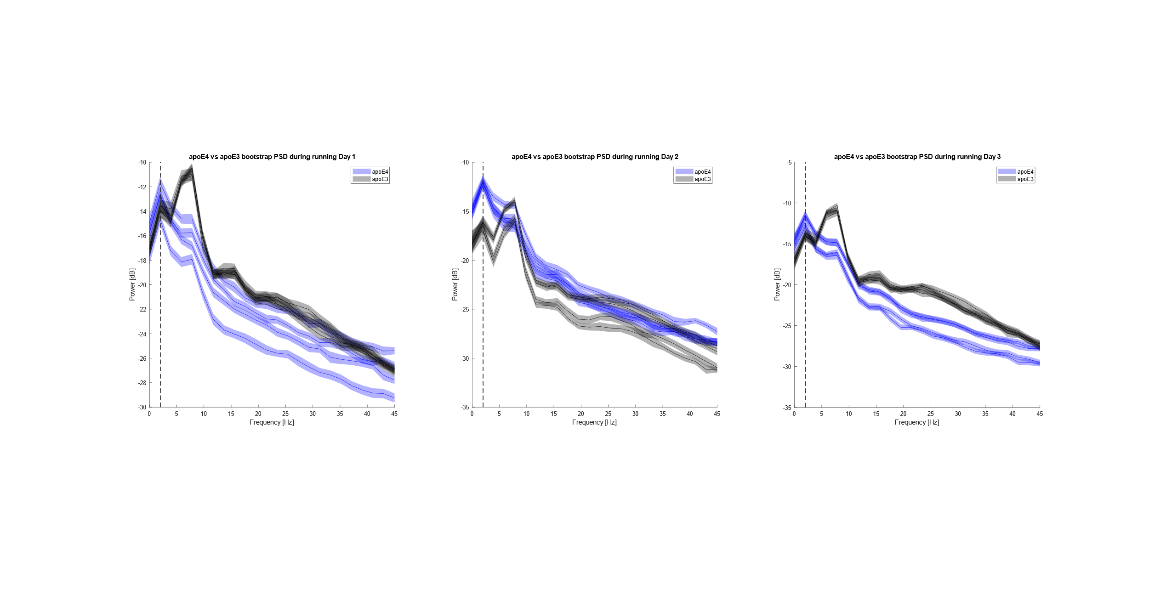
ApoE4 v/s WT
N = (5, 6)
Circle Track
Electrophysiological data analyses
Bootstrap CI during running shows differences in PSD in apoE4 model

Slide 7
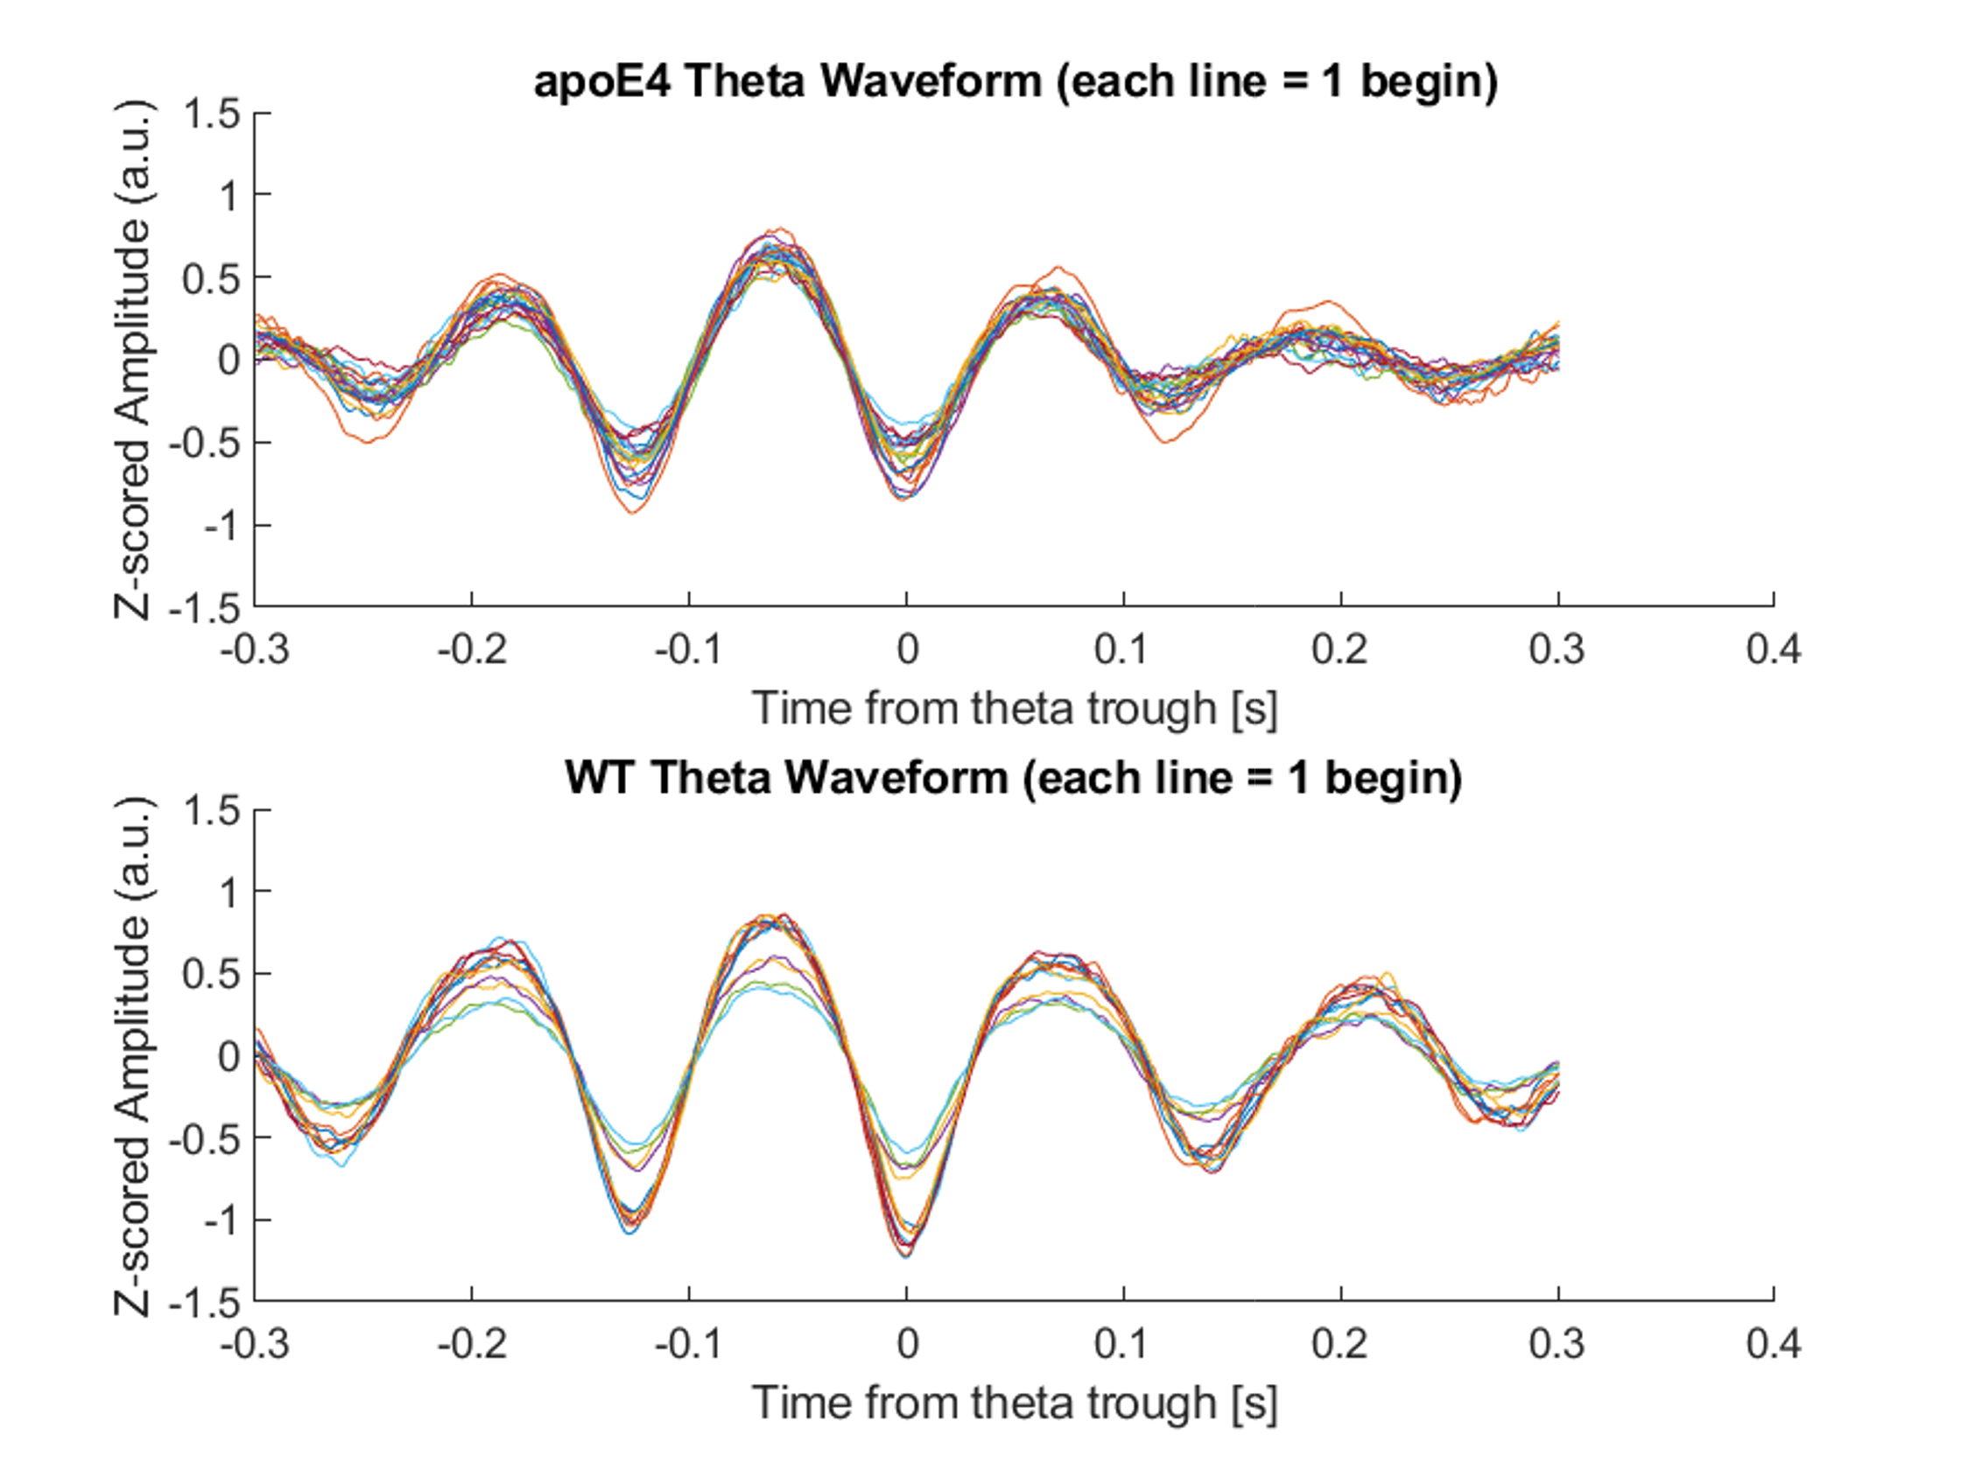
ApoE4 v/s WT
N = (5, 6)
Circle Track
Electrophysiological data analyses
Jitter during “theta mode” in apoE4 model compared to apoE3

Slide 8
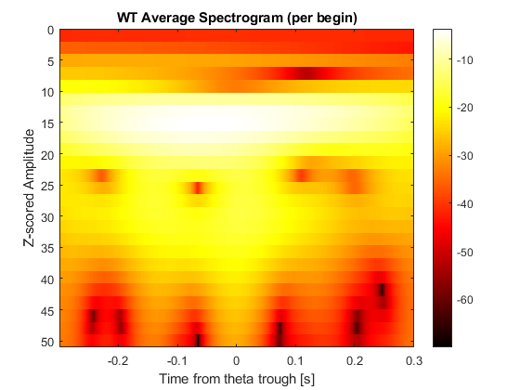
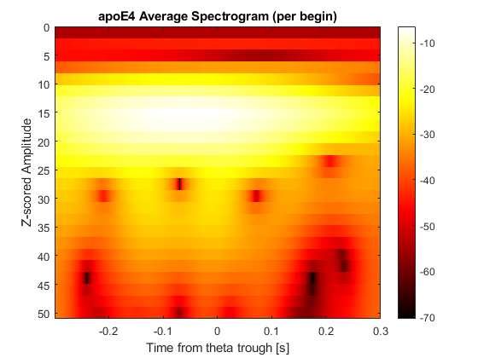
ApoE4 v/s WT
N = (5, 6)
Circle Track
Electrophysiological data analyses
Increased slow gamma power during “theta mode” in apoE4 model

Slide 9
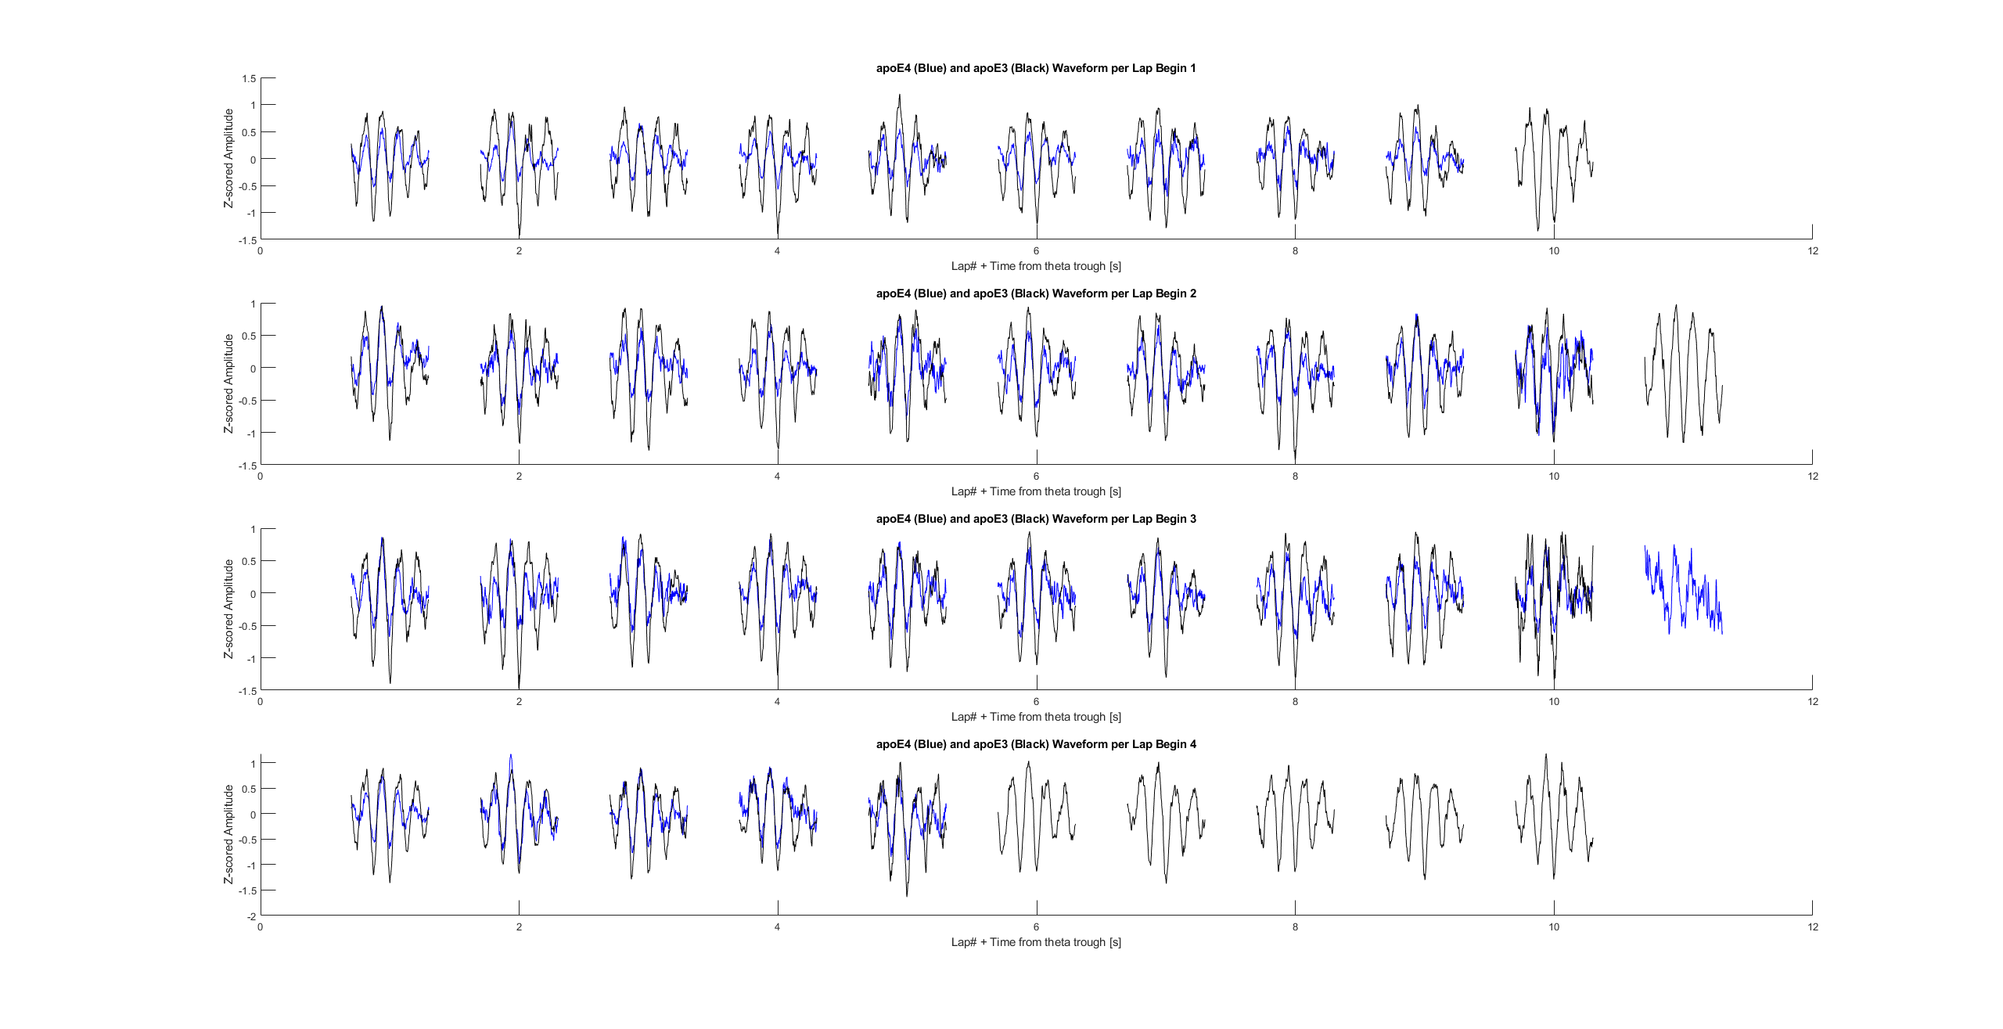
Average theta waveform per lap shows decrease in power (consistent across days)

Slide 10
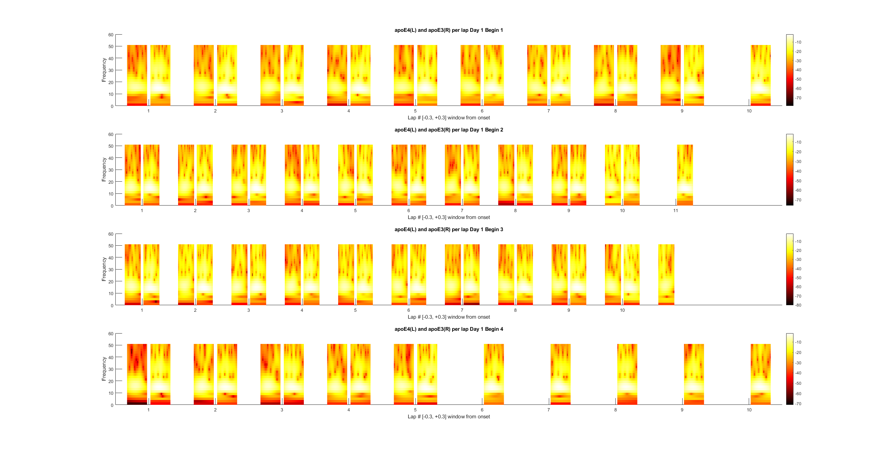
Average theta spectrogram per lap shows decrease in power (consistent across days)

Slide 11
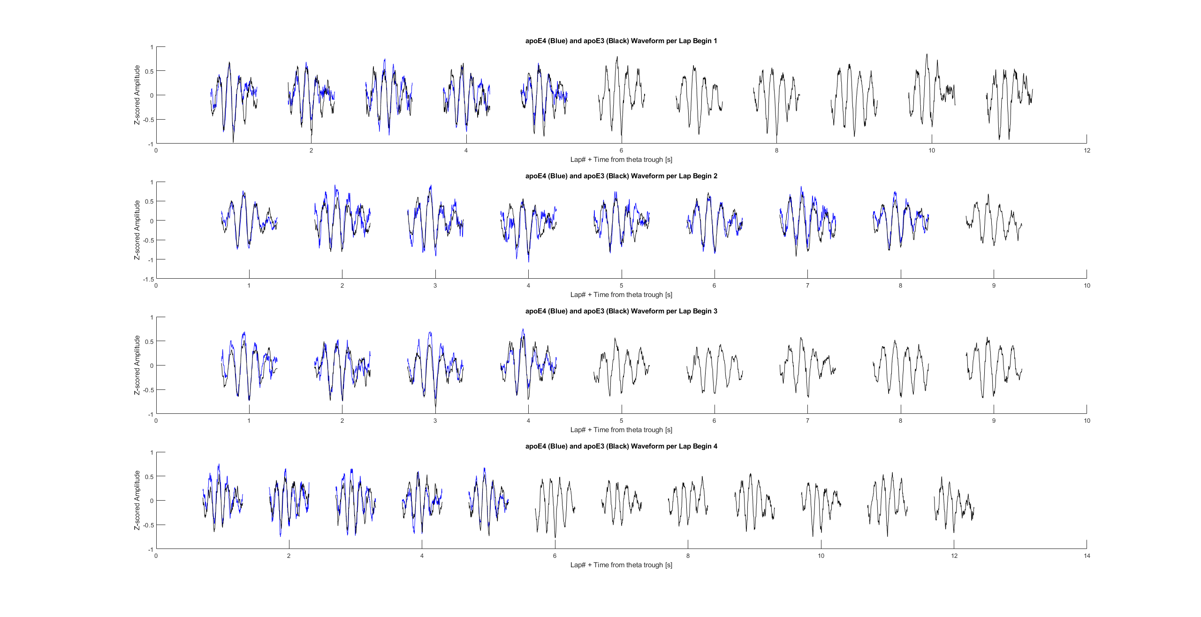
Average theta waveform per lap shows decrease in power (consistent across days)

Slide 12
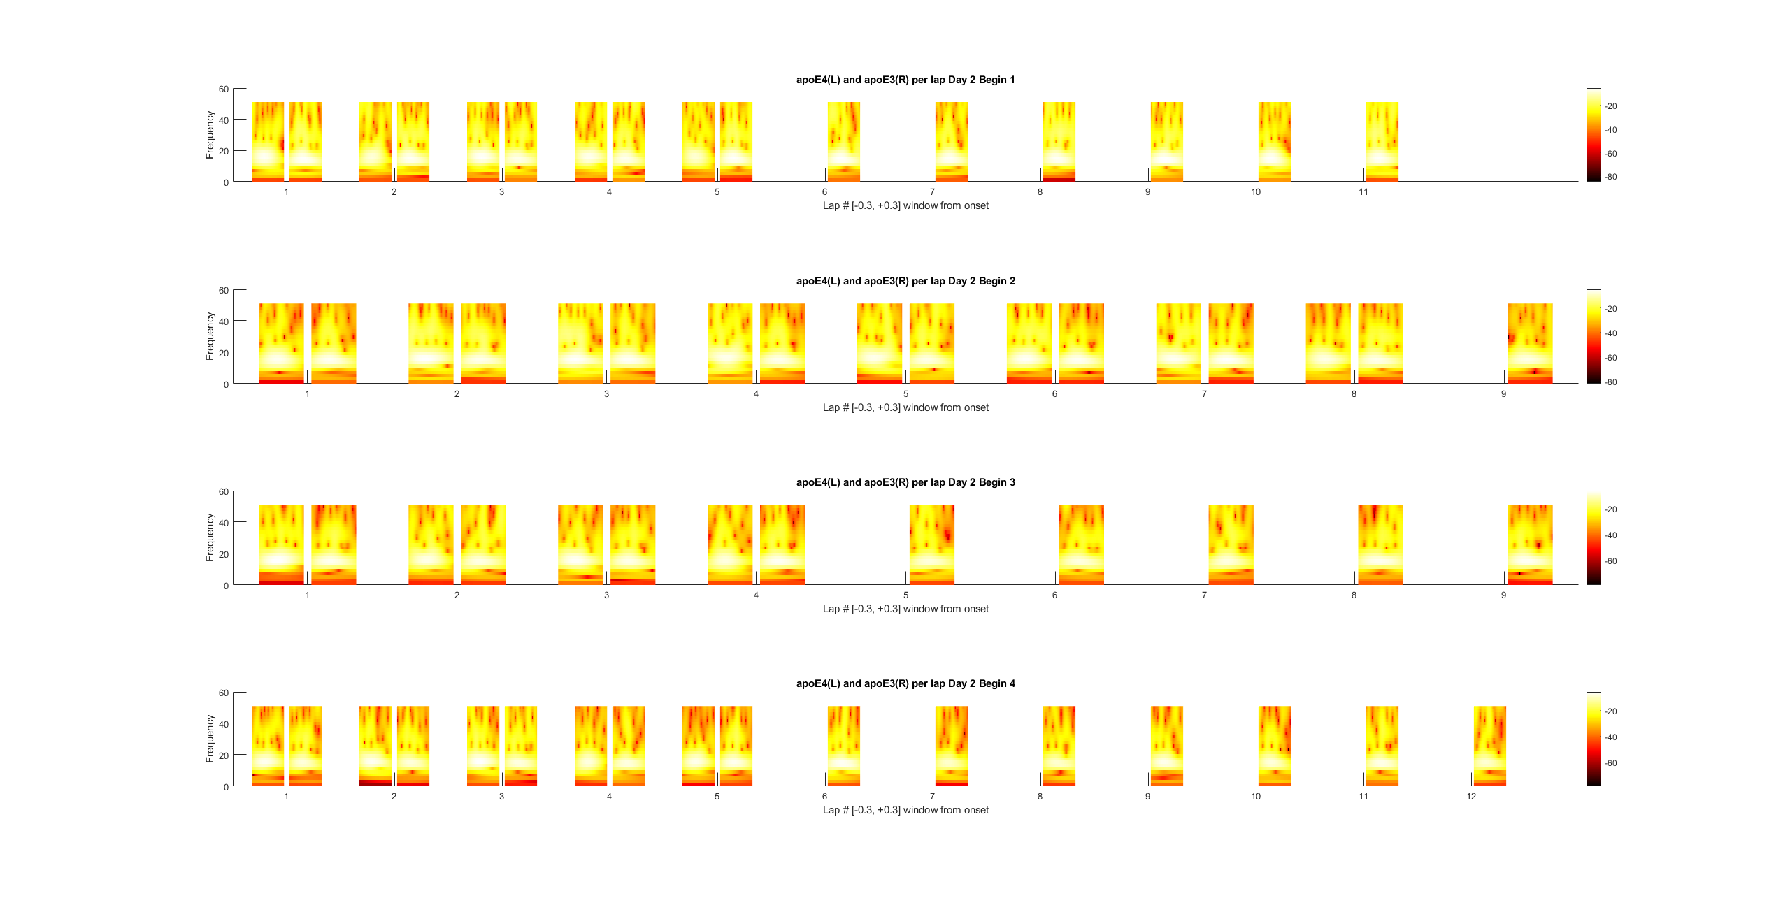
Average theta spectrogram per lap shows decrease in power (consistent across days)

Slide 13
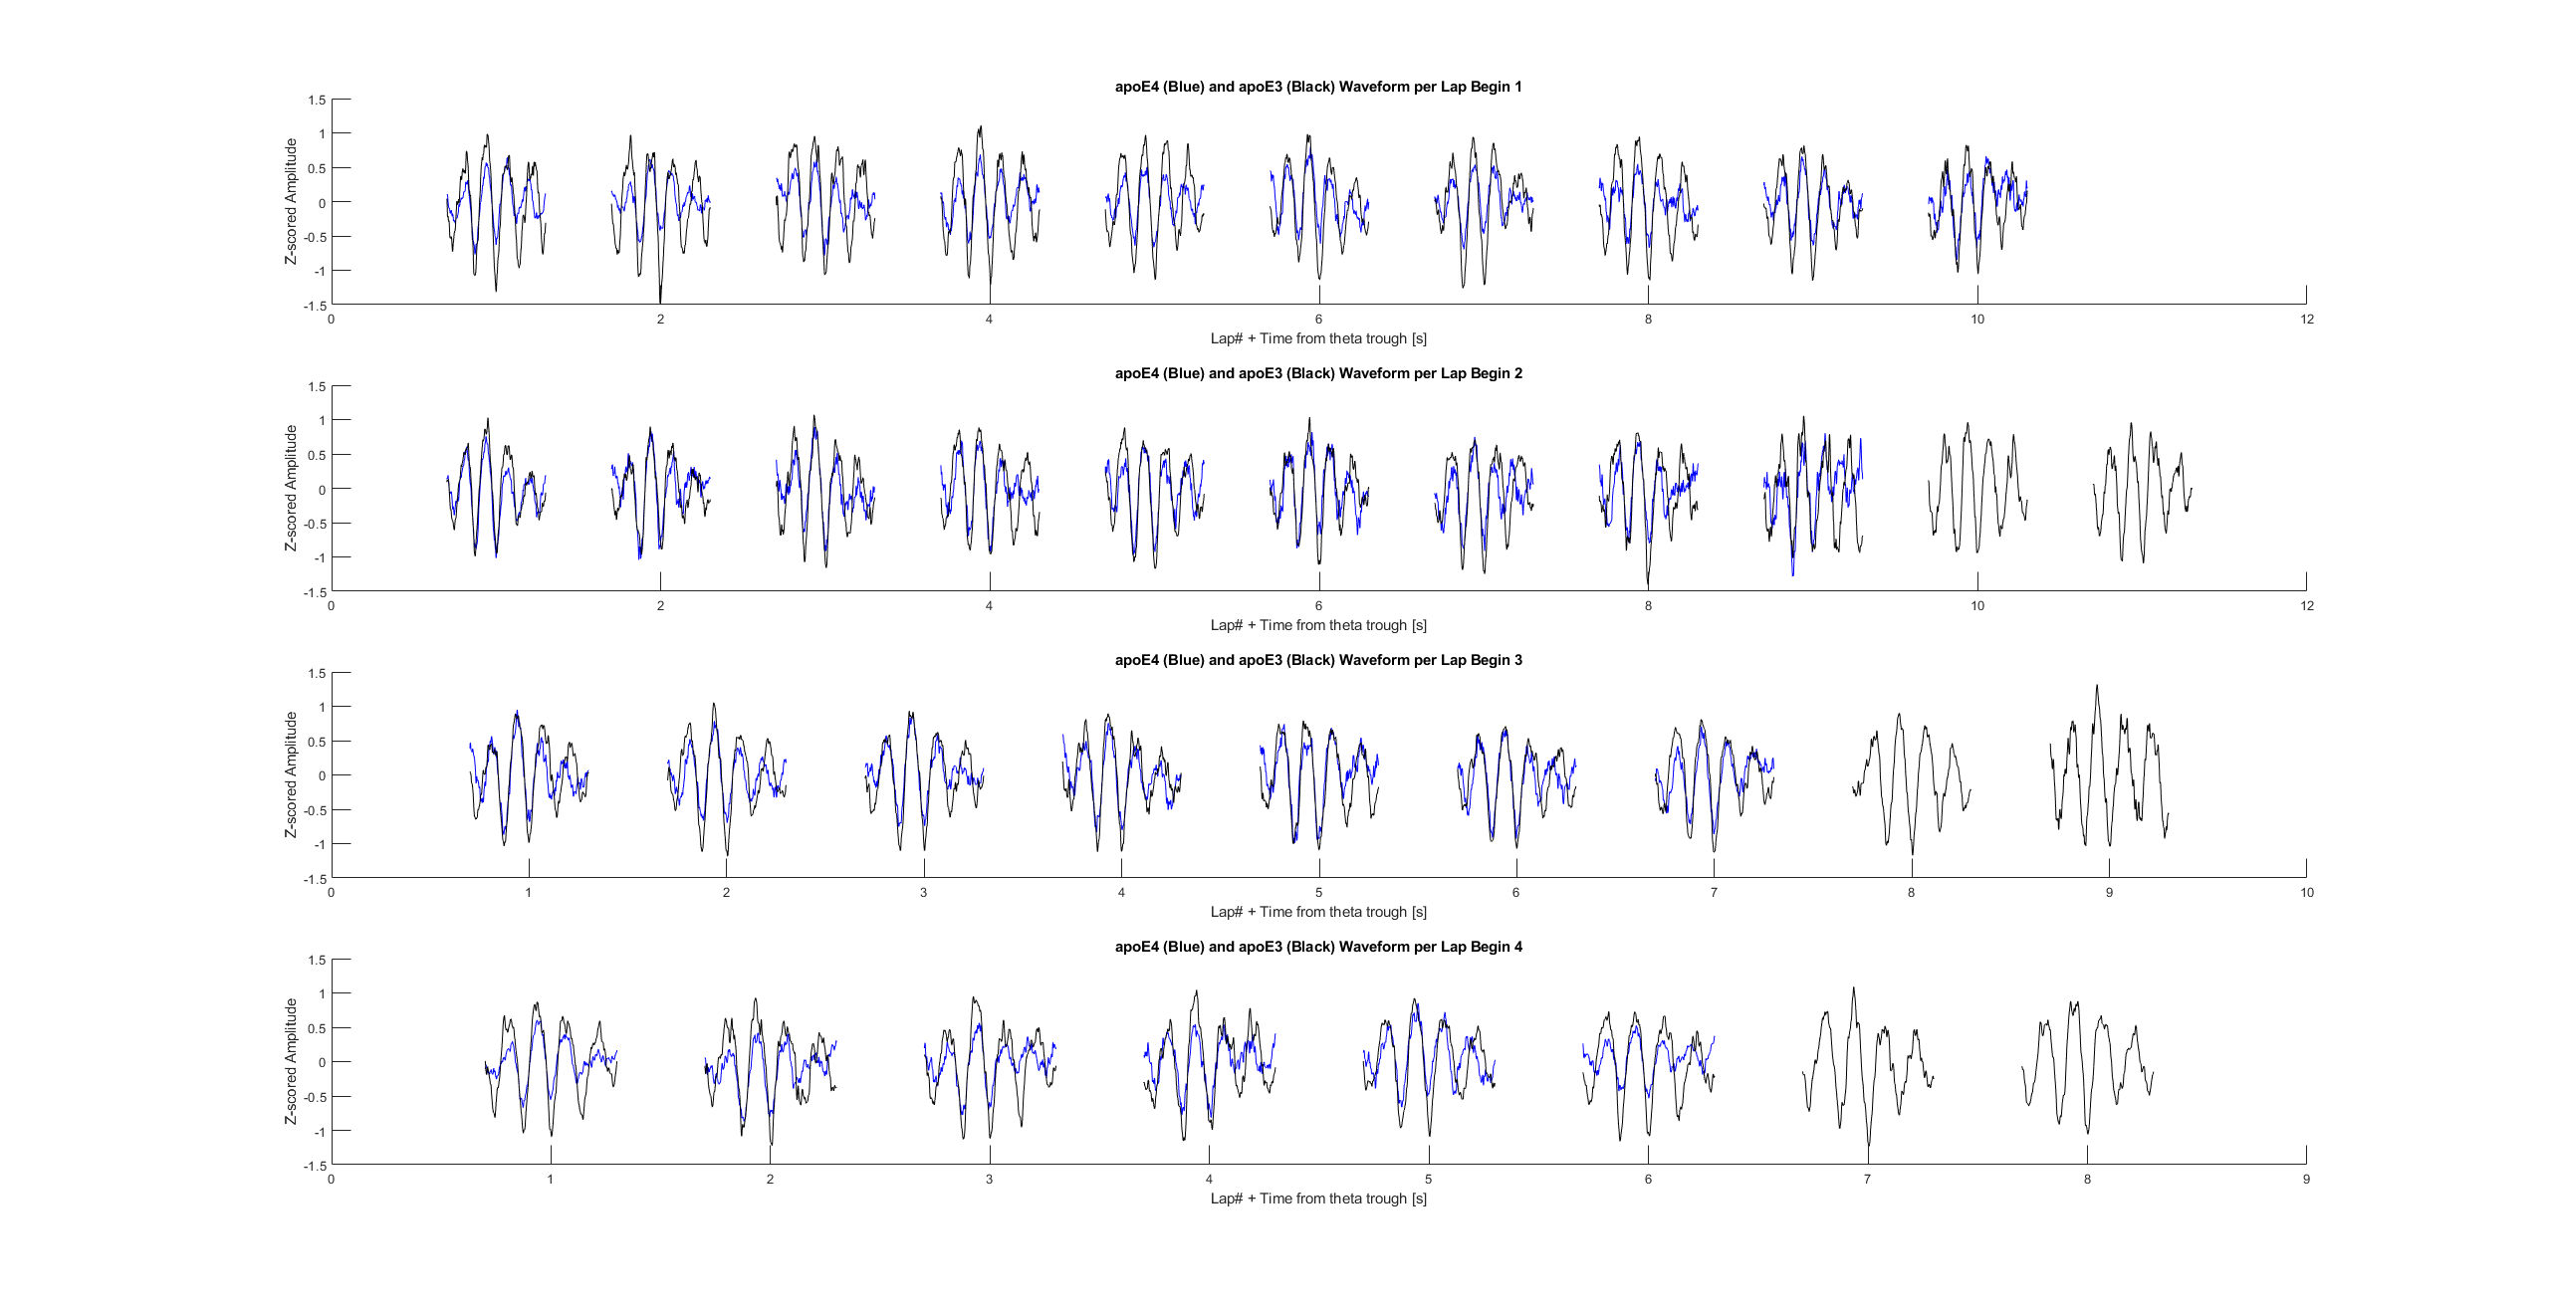
Average theta waveform per lap shows decrease in power (consistent across days)

Slide 14
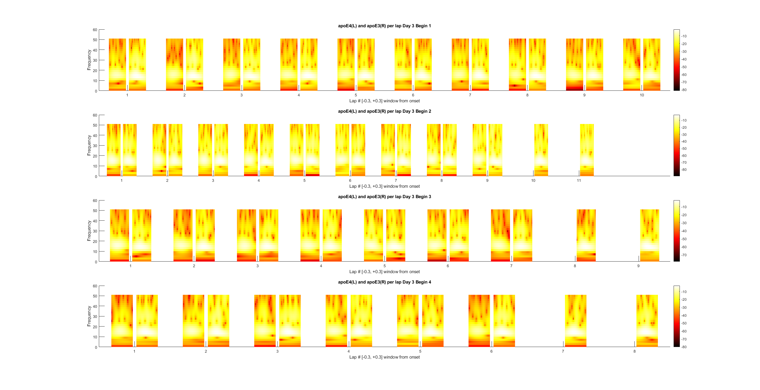
Average theta spectrogram per lap shows decrease in power (consistent across days)

Slide 15
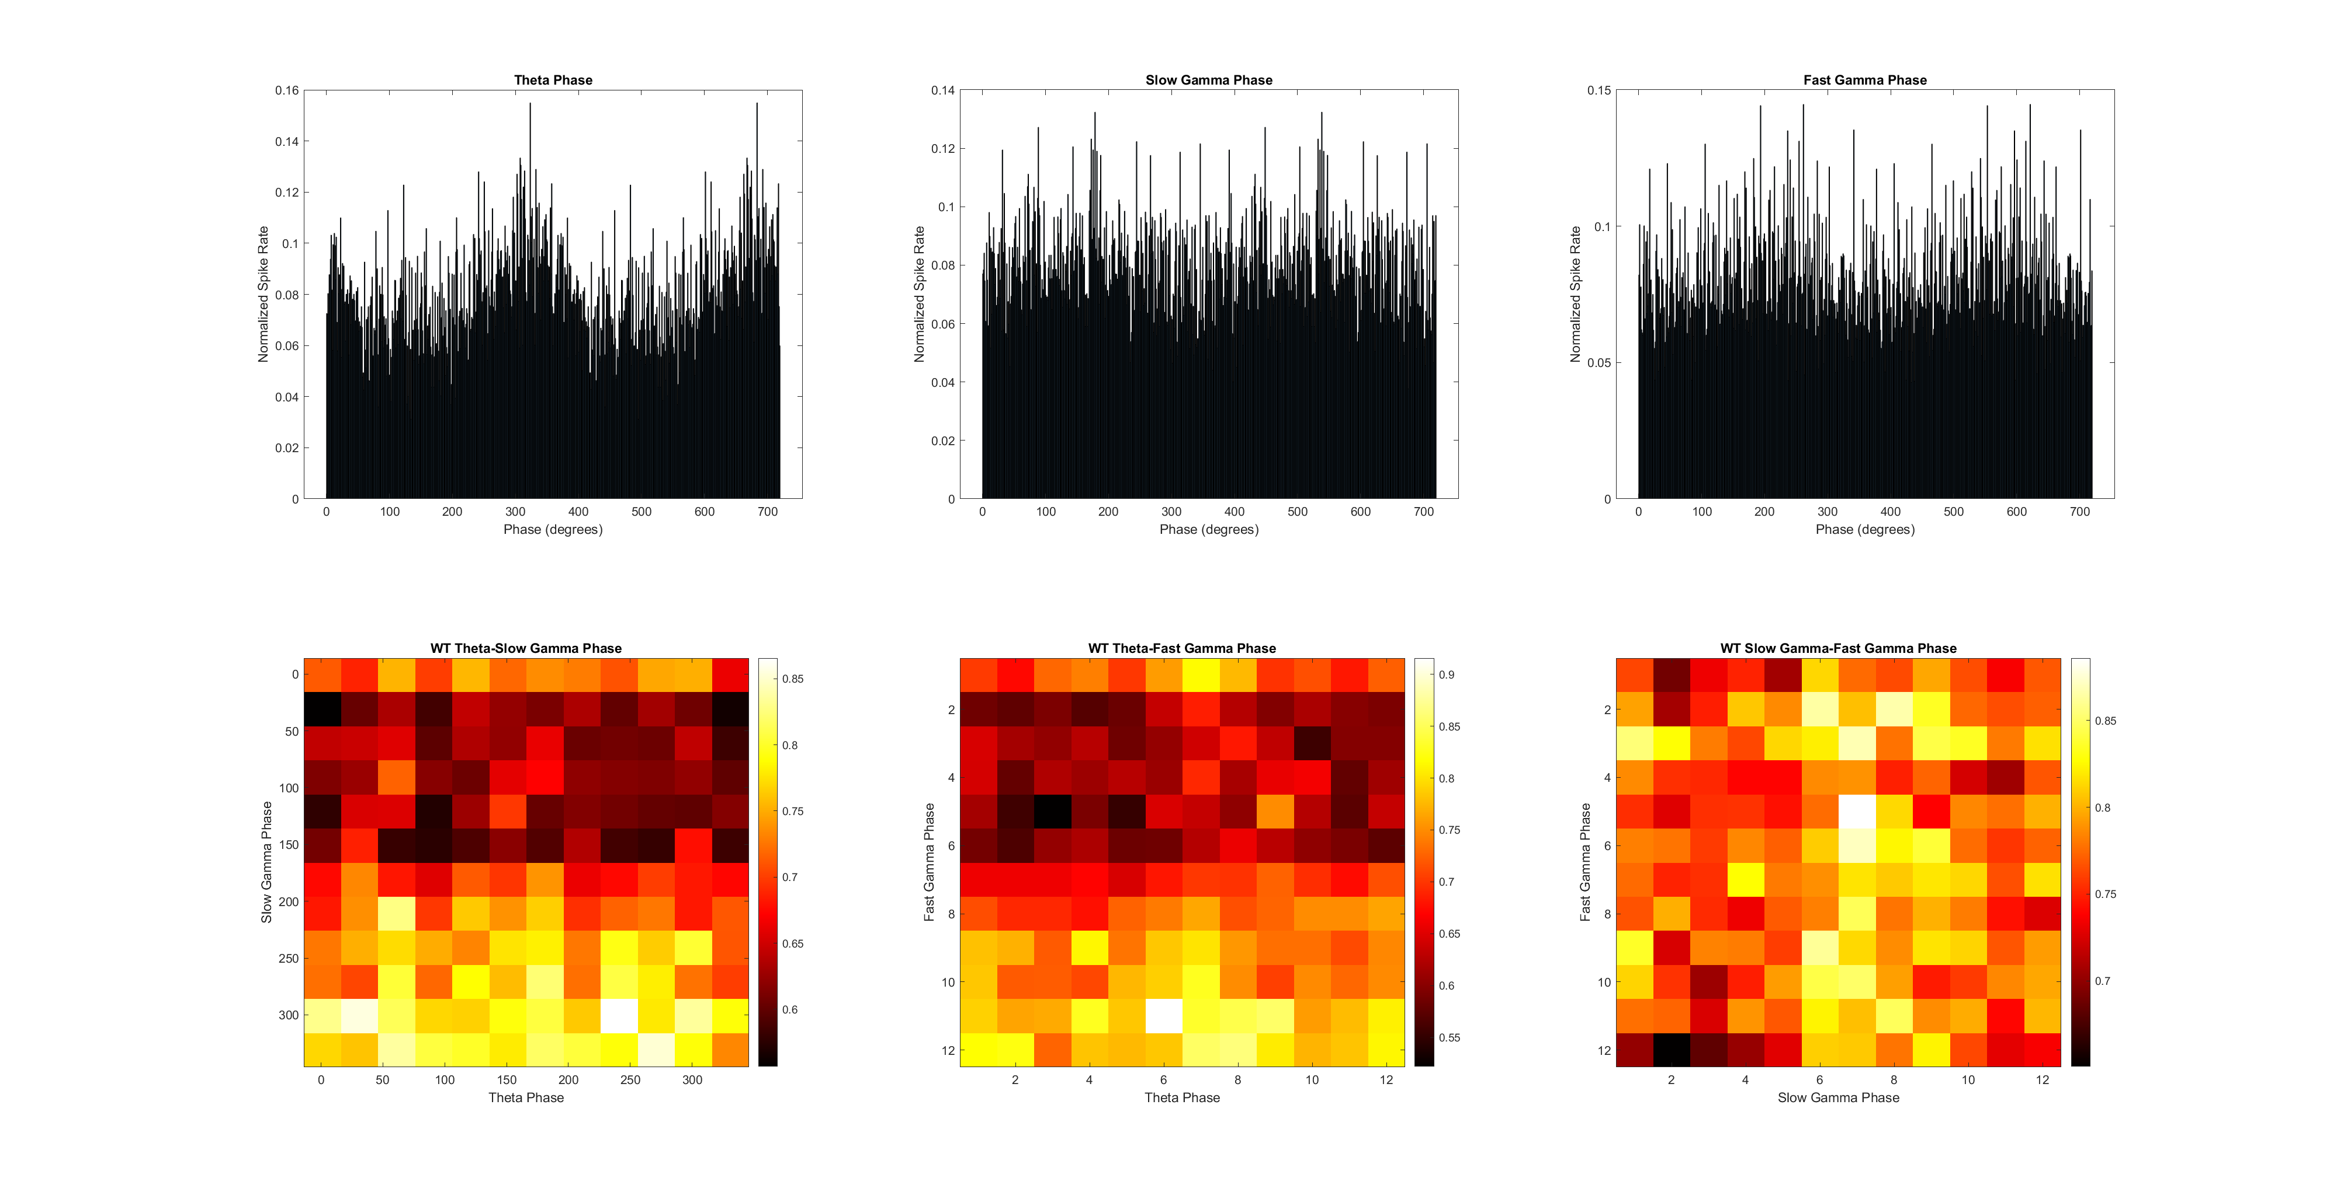
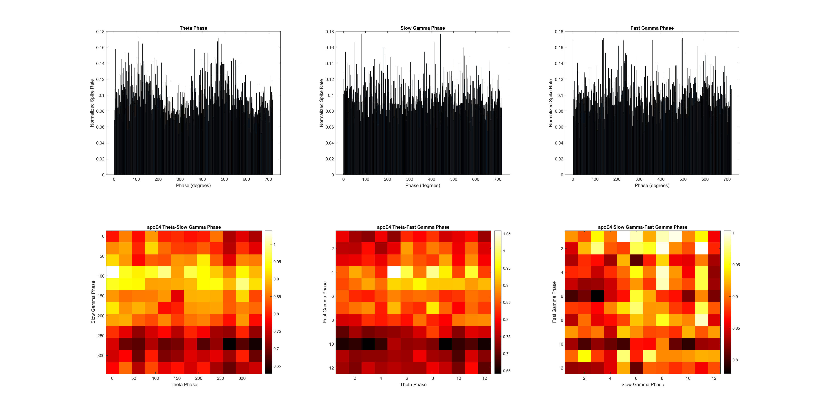
ApoE4 v/s WT
N = (5, 6)
Circle Track Day 1
Electrophysiological data analyses
Phase-Phase Synchrony between theta, slow gamma, and fast gamma

Slide 16
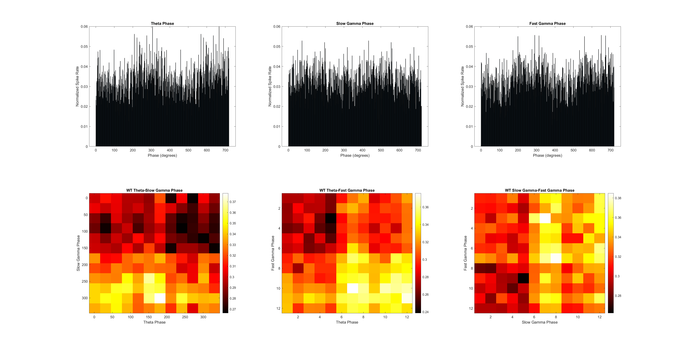
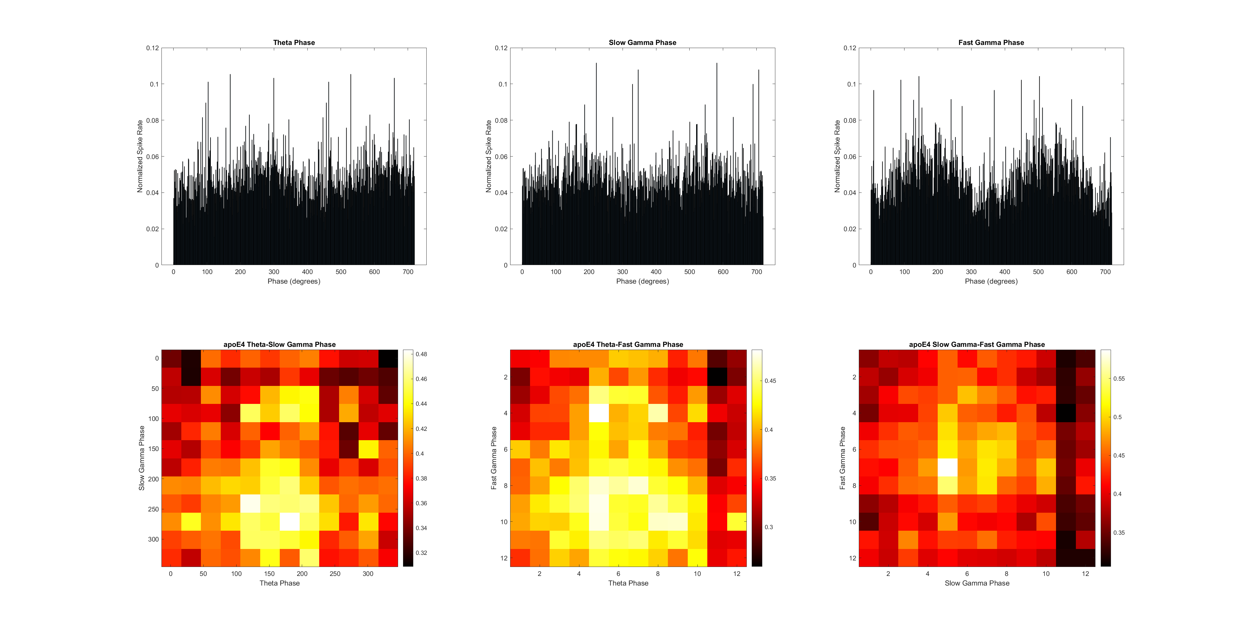
ApoE4 v/s WT
N = (5, 6)
Circle Track Day 2
Electrophysiological data analyses
Phase-Phase Synchrony between theta, slow gamma, and fast gamma

Slide 17
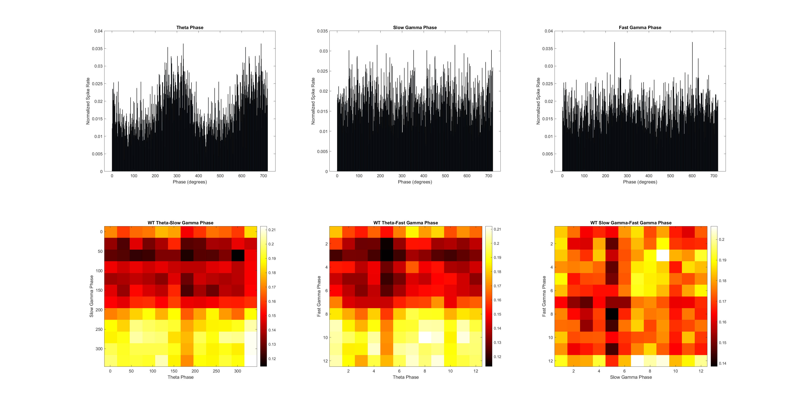
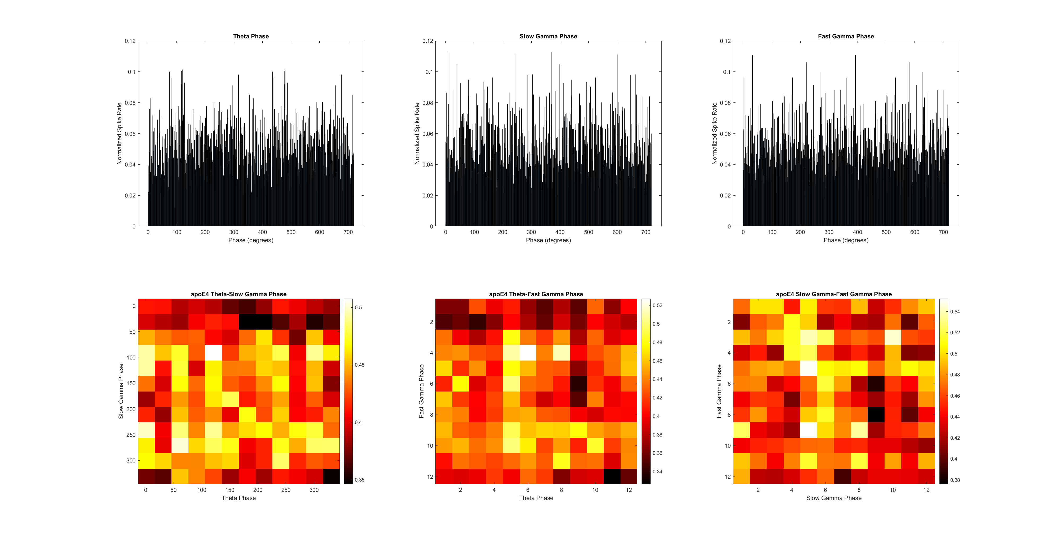
ApoE4 v/s WT
N = (5, 6)
Circle Track Day 3
Electrophysiological data analyses
Phase-Phase Synchrony between theta, slow gamma, and fast gamma

